Slide 1
Optical Character Recognition with Manual segmentation

Slide 2
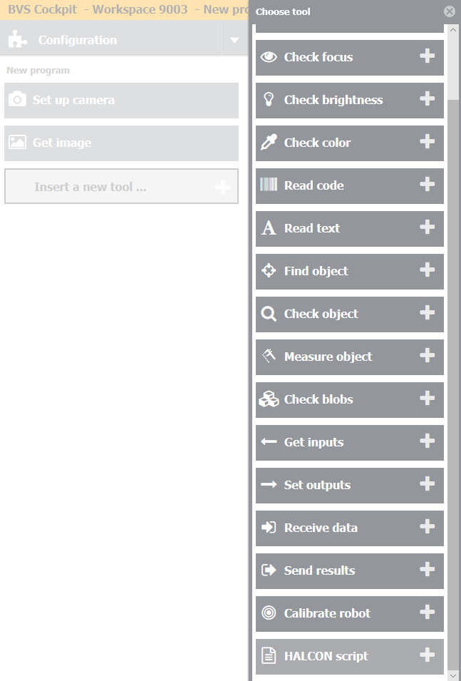
Step 1
Add new tool – Halcon Script – in your inspection program.

Slide 3
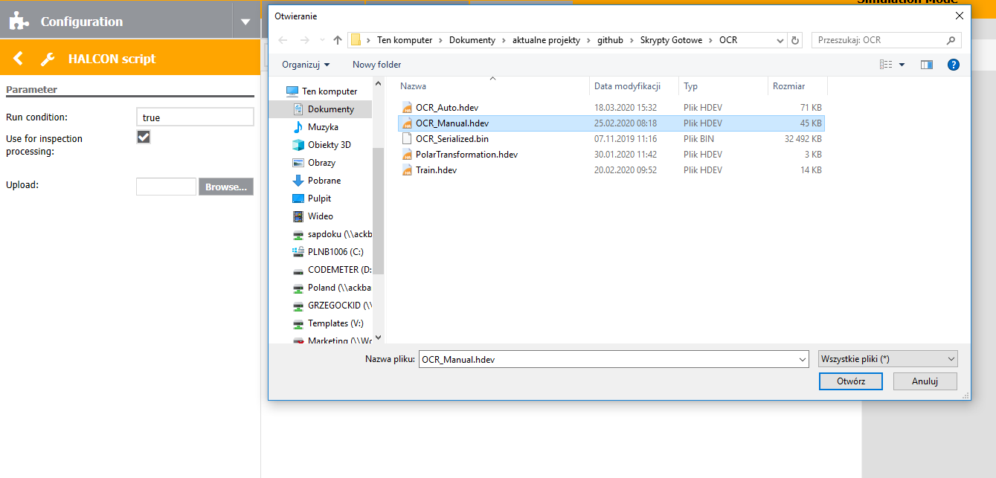
Step 2
Click „Browse” and choose „OCR_Manual.hdev” file.

Slide 4
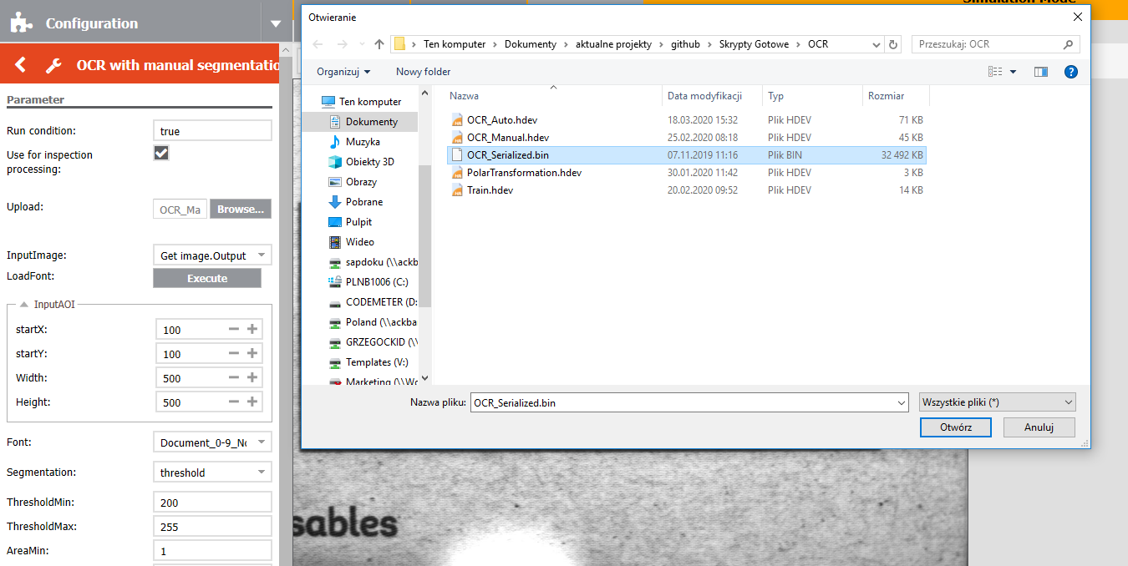
Step 3
Click „Browse” once again and choose „OCR_Serialized.bin” file.

Slide 5
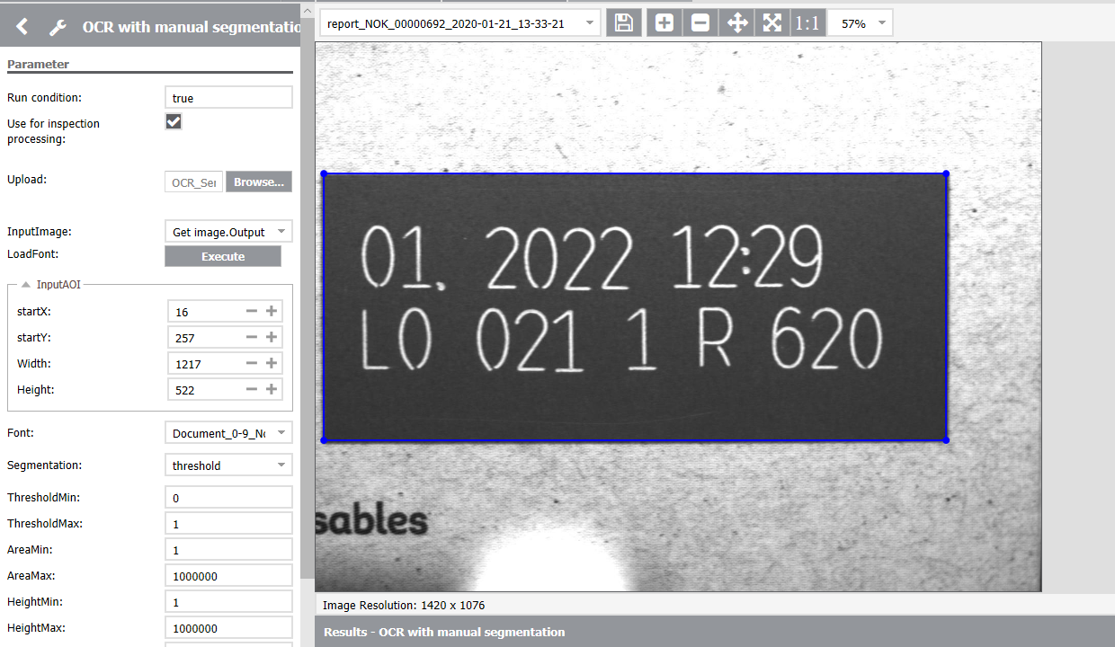
Step 4
Set the AOI to the characters that you want to read.

Slide 6
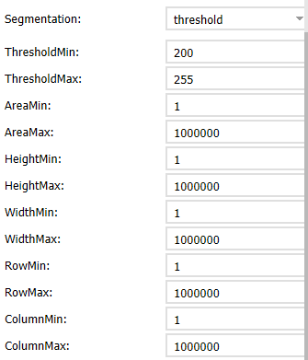
Step 5
Adjust segmentation parameters:
ThresholdMin – minimum value for threshold
ThresholdMax – maximum value for threshold
AreaMin – minimum value for character’s area
AreaMax – maximum value for character’s area
HeightMin – minimum value for character’s height
HeightMax – maximum value for character’s height
WidthMin – minimum value for character’s width
WidthMax – maximum value for character’s width
RowMin – minimum value for character’s row position
RowMax – minimum value for character’s row position
ColumnMin – minimum value for character’s column position
ColumnMax – maximum value for character’s column position

Slide 7
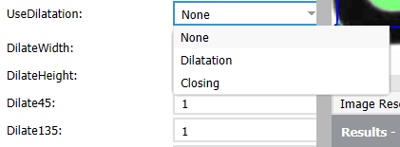
Step 6
Choose whether to use Dilatation, Closing or None of them.
If you choose Closing you can set following parameters:
DilateHeight – closing in vertical direction
DilateWidth – closing in horizontal direction
Dilate45 – closing in 45° direction
Dilate135 – closing in 135° direction
If you choose Dilatation you can set following parameters:
DilateHeight – dilation in vertical direction
DilateWidth – dilation in horizontal direction
If you choose None „Dilate…” parameters will not change anything.

Slide 8
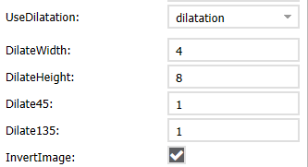
Step 7
Choose if the image should be inverted.

Slide 9
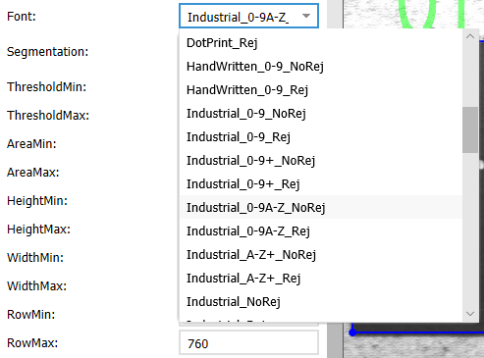
Step 8
Choose Font from drop-down list box.
If you want to use your trained font set Path in which new font was saved.
For BVS Cockpit PC version you can set any path you want (for example: "C:/Users/User/Desktop/„).
For BVS Cockpit in SVC you have to set path in “/data/icsServer/share/images/”
For BVS Cockpit in SC you have to set path in “../images/”
Be sure that the folder exists.
Be sure that there are no blank spaces in your path.
It’s better to type in the path in the box from scratch that copying it because it may cause various problems.
Click “Execute” on the right of “LoadFont” to load chosen font.

Slide 10
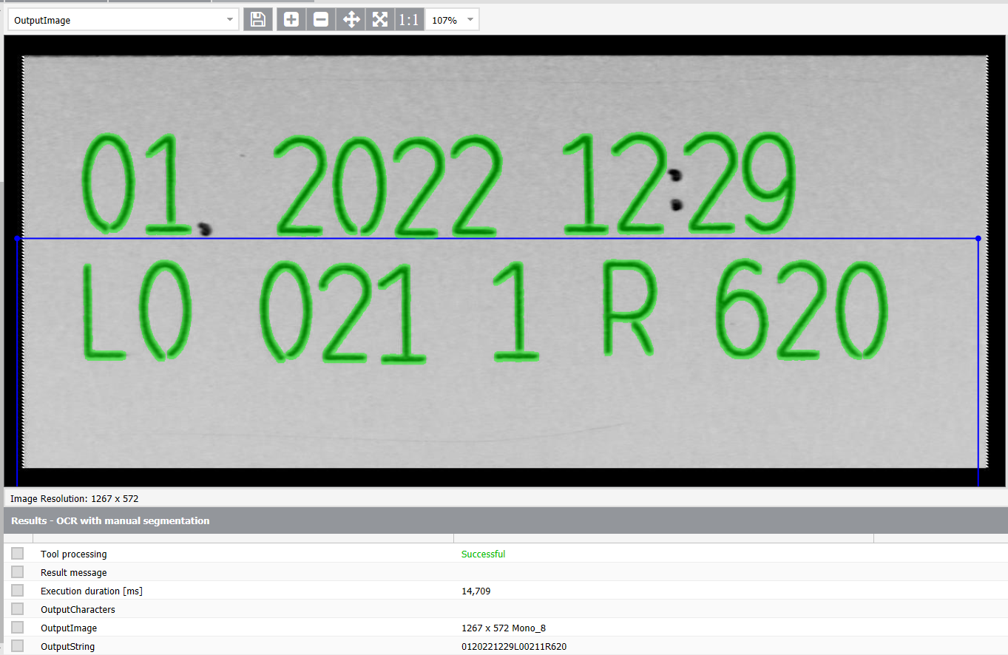
Step 8
Found text will be in OutputCharacters variable (as green regions) on OutputImage. Read characters will be in OutputString variable.

Slide 11
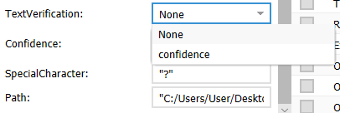
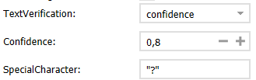
Step 9
There is also possibility to use verification method on the read characters. You can choose whether to use Confidence or None.
If you choose Confidence you can set following parameters:
Confidence – if the confidence (probability) of the character will be below this value SpecialCharacter will be displayed instead of read character
SpecialCharacter – special character which will replace character with low cofidence value
If you choose None option all of the above parameters will not change anything.

